Slide 1
05
Implementing APIs

Slide 2
Implementing Application Programming Interfaces
01
02
03
Requests library
Analyzing JSON file
Installing and working with Requests library
Working with Json formatter
Working with API
Animal Crossing New Horizons API
Weather API
Cocktail database API

Slide 3
API
API stands for "Application Programming Interface."
It's a set of rules and protocols that allow how different software applications can communicate and interact with each other.
APIs define the methods and data formats that applications can use to request and exchange information.
To retrieve data from a web server, a client application initiates a request, and the server responds with the requested data.
Notes:
Imagine an API as a waiter in a restaurant. You tell the waiter what you want (your order), and they communicate your request to the kitchen. The kitchen prepares your food, and the waiter brings it back to you. Similarly, you send a request to an API, and it processes your request and then returns the results.

Slide 4
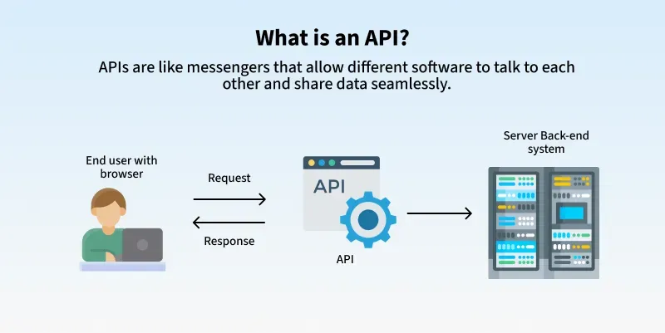

Slide 5
APIs act as bridges that enable the smooth exchange of data and functionality, enhancing interoperability across various applications.

Slide 6
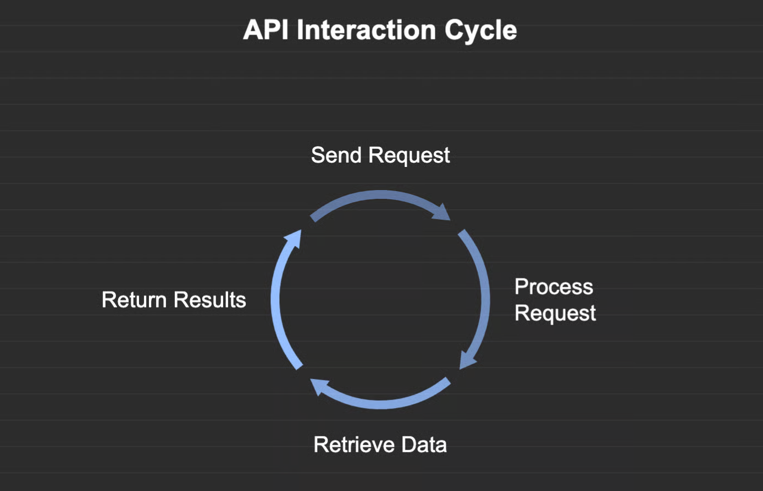

Slide 7
How it works:
You send requests (e.g., GET, POST, PUT, DELETE) to specific API endpoints (URLs) and receive responses, often in JSON or XML format, which you then process in your Python code.

Slide 8
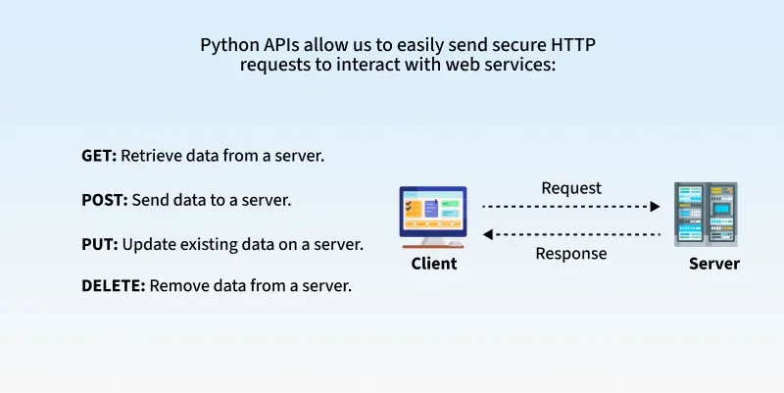

Slide 9
Making API Requests in Python
In order to work with APIs, some tools are required, such as requests module and we need to first install them in our system.
requests: A widely used library for making HTTP requests to web APIs.
Command to install 'requests':
pip install requests
py - m pip install requests
Once we have installed it, we need to import it in our code to use it.
Command to import 'requests':
import requests

Slide 10
The basics of API requests
Find the Right Place: Identify the API endpoint, which is the specific web address where you'll send your request.
Place Your Order: Use Python's requests library to send the request to the API. You'll specify what kind of action you want to take (like getting data or sending data).
Get Your Food: The API will send back a response, which you can process to extract the information you need.

Slide 11
GET requests
A GET request is the most common type of HTTP request used to retrieve data from a server, similar to asking for information;
when you type a URL into your browser and press enter, you're essentially sending a GET request to that server, specifying the desired resource, which the server processes to find and prepare the requested data before sending it back in a format like JSON or XML.
Notes:
JSON (JavaScript Object Notation) is a lightweight, text-based format for structuring data that is human-readable and easy for machines to parse and generate. It's commonly used for transmitting data between a server and a web application, and it is language-independent, meaning it can be used with many programming languages like JavaScript, Python, and Java.

Slide 12
import requests
response = requests.get('https://api.example.com/data')
data = response.json()
print(data)
Notes:
we're sending a GET request to a fictional API and printing the JSON response. GET requests are commonly used to fetch data without modifying it.
jasON and XML are two common data interchange formats,

Slide 13
Understanding API Status Codes
Status codes tell us how the server handled our request:
200 OK: Request successful, data returned.
201 Created: New resource created.
204 No Content: Success but no data returned.
400 Bad Request: Invalid request.
401 Unauthorized: Missing or invalid API key.
500 Internal Server Error: Server encountered an error.
These codes help in debugging and managing API responses.

Slide 14
Working with Cocktail DB:
An open, crowd-sourced database of drinks and cocktails from around the world. We also offer a free cocktail API for anyone wanting to use it.
https://www.thecocktaildb.com/api.php

Slide 15
Get Request
import requests
# Example: Get the details of a specific cocktail by ID
cocktail_id = "11007"
url = f"https://www.thecocktaildb.com/api/json/v1/1/lookup.php?i={cocktail_id}" response = requests.get(url)
data = response.json()
print(data)

Slide 16
Exercise
import requests
import json
url = f"https://www.thecocktaildb.com/api/json/v1/1/random.php" response = requests.get(url)
data = response.json()
#write the data to json file for analysing the data with open("jsonEx1.json",'w') as file:
json.dump(data,file,indent=4) print(data["drinks"][0]) print(data["drinks"][0]['strDrink']) # drink = data["drinks"]
# print(drink[0]['strDrink'])
Notes:
Requests a random cocktail from TheCocktailDB API
Saves the full JSON response into a file (jsonEx1.json)
Prints the entire drink object
Prints only the drink name (strDrink)

Slide 17
Exercise
url = f"https://www.thecocktaildb.com/api/json/v1/1/search.php?s=margarita"
response = requests.get(url)
data = response.json() print(data)
drink = data["drinks"]
for i in range(0,len(drink)):
print("Name of drink is ",drink[i]['strDrink']," \nID of drink is ",drink[i]['idDrink'])
# or
for i in data["drinks"]:
print("Name of drink is ",i['strDrink']," \nID of drink is ",i['idDrink'])

Slide 18
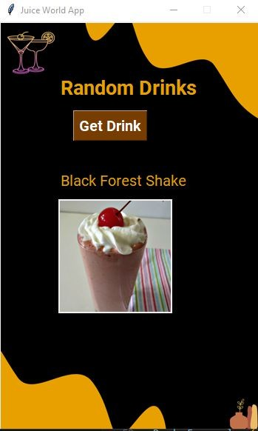
Exercise
Using cocktailDB API
Retrieve image into Tkinter App

Slide 19
Fetch random drink
Retrieve drink image URL
Download image bytes
Convert to Tkinter image
Show in Label

Slide 20
import requests
import json
import io
from PIL import Image, ImageTk
import tkinter as tk from tkinter import Label, Button

Slide 21
def get_drink():
url = "https://www.thecocktaildb.com/api/json/v1/1/random.php"
response = requests.get(url)
data = response.json()
drink = data["drinks"][0]
drink_name = drink["strDrink"]
drink_image_url = drink["strDrinkThumb"]
# update drink name in GUI
drink_label.config(text=drink_name)
# fetch drink image
img_response = requests.get(drink_image_url)
img_data = img_response.content
# convert bytes → PIL → Tkinter
pil_image = Image.open(io.BytesIO(img_data))
pil_image = pil_image.resize((250, 250)) # resize for GUI
tk_image = ImageTk.PhotoImage(pil_image)
# update image label
image_label.config(image=tk_image)
image_label.image = tk_image # keep reference (IMPORTANT)

Slide 22
root = tk.Tk()
root.title("Juice World App")
root.geometry("400x550")
root.config(bg="black")
title = Label(root, text="Random Drinks", font=("Arial", 20, "bold"),
bg="black", fg="orange")
title.pack(pady=10)
btn = Button(root, text="Get Drink", font=("Arial", 14, "bold"),
bg="orange", fg="white", command=get_drink)
btn.pack(pady=10)
drink_label = Label(root, text="", font=("Arial", 16, "bold"),
bg="black", fg="white")
drink_label.pack(pady=10)
image_label = Label(root, bg="black")
image_label.pack(pady=10)
root.mainloop()

Slide 23
Exercise
Click Here For text ﬁle Image File
Template File
1 . Import libraries and Create root window with frame

Slide 24
import requests
import json
import io
from PIL import Image, ImageTk
import tkinter as tk
from tkinter import Label, Button
# -----------------------
# Function to load drink
# -----------------------
def get_drink():
url = "https://www.thecocktaildb.com/api/json/v1/1/random.php"
response = requests.get(url)
data = response.json()
drink = data["drinks"][0]
drink_name = drink["strDrink"]
drink_image_url = drink["strDrinkThumb"]
# update drink name in GUI
drink_label.config(text=drink_name)
# fetch drink image
img_response = requests.get(drink_image_url)
img_data = img_response.content
# convert bytes → PIL → Tkinter
pil_image = Image.open(io.BytesIO(img_data))
pil_image = pil_image.resize((250, 250)) # resize for GUI
tk_image = ImageTk.PhotoImage(pil_image)
# update image label
image_label.config(image=tk_image)
image_label.image = tk_image # keep reference (IMPORTANT)
# -----------------------
# GUI Window
# -----------------------
root = tk.Tk()
root.title("Juice World App")
root.geometry("400x550")
root.config(bg="black")
title = Label(root, text="Random Drinks", font=("Arial", 20, "bold"),
bg="black", fg="orange")
title.pack(pady=10)
btn = Button(root, text="Get Drink", font=("Arial", 14, "bold"),
bg="orange", fg="white", command=get_drink)
btn.pack(pady=10)
drink_label = Label(root, text="", font=("Arial", 16, "bold"),
bg="black", fg="white")
drink_label.pack(pady=10)
image_label = Label(root, bg="black")
image_label.pack(pady=10)
root.mainloop()

Slide 25
Exercise
2. Retrieve Image
def getData():
url = f"https://www.thecocktaildb.com/api/json/v1/1/random.php" response = requests.get(url)
data = response.json()
Drink_name = data["drinks"][0]['strDrink'] # Access Drink name drinkName.config(text=Drink_name)
image_url = data['drinks'][0]['strDrinkThumb'] # Access Drink image url image_response = requests.get(image_url)
if image_response.status_code == 200:
image = Image.open(BytesIO(image_response.content)) image = image.resize((150,150))
image = ImageTk.PhotoImage(image) image_label = Label(root, image=image) image_label.image = image
# keep a reference to the image to prevent garbage collection image_label.place(x=100, y=180)

Slide 26
Exercise
Click Here Code File

Slide 27
Exercise
Using cocktailDB API
Create an app to access cocktail Database using API
Use a logo to the app
Name the app as Juice World
Create multiple frames
First frame - as shown in Slide number 170
Second frame - as shown in slide number 171
Third frame - as shown in the slide number 172
Fourth frame is up to you…

Slide 28
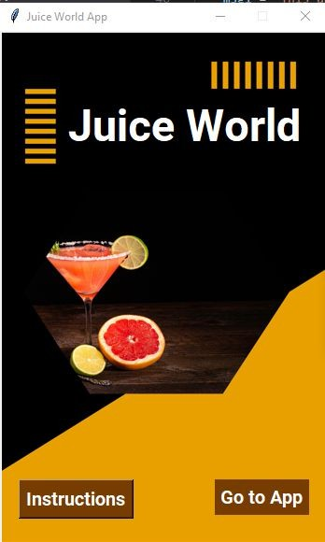
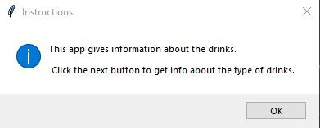
Exercise
Click Here For ﬁle Image File
FirstFrame
Use 1.png as background
Add Label Juice World
Add two buttons - Instructions and Go to App
When clicks on Instructions open message box guiding user to use app
When user clicks on Go to App button it opens second frame

Slide 29
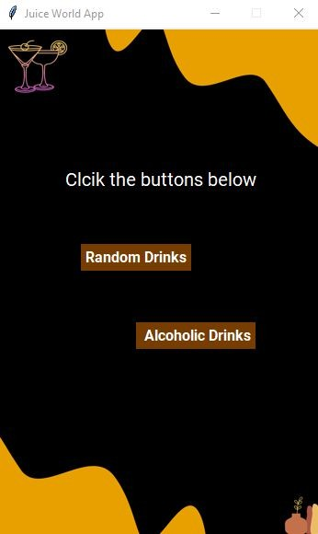
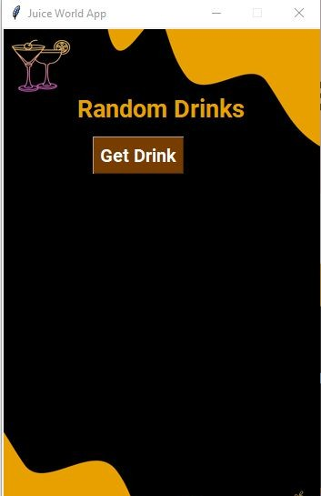
Second Frame
Exercise
Click Here For text ﬁle Image File
Use 2.png as background
Add Label “Click the buttons below”
Add two buttons -
  Random Drinks
  Alcoholic Drinks
Upon clicking the Random Drinks buttons open the RandomDrinks frame
Upon clicking the Alcoholic Drinks buttons open the Alcoholic Drinks frame

Slide 30
Exercise
For template ﬁle Click Below Template File

Slide 31
Exercise
Code File Click Here

